Slide 1

IMAGE RECOGINITION WITH IBM CLOUD VISUAL RECOGNITION

Slide 2
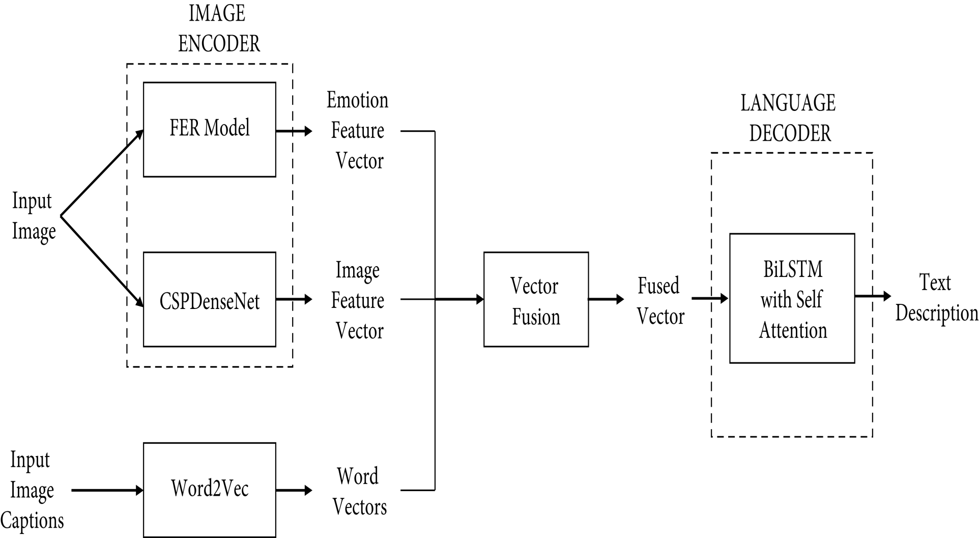
GENERATING OF FRAME WORK
FIGURE 1

Slide 3
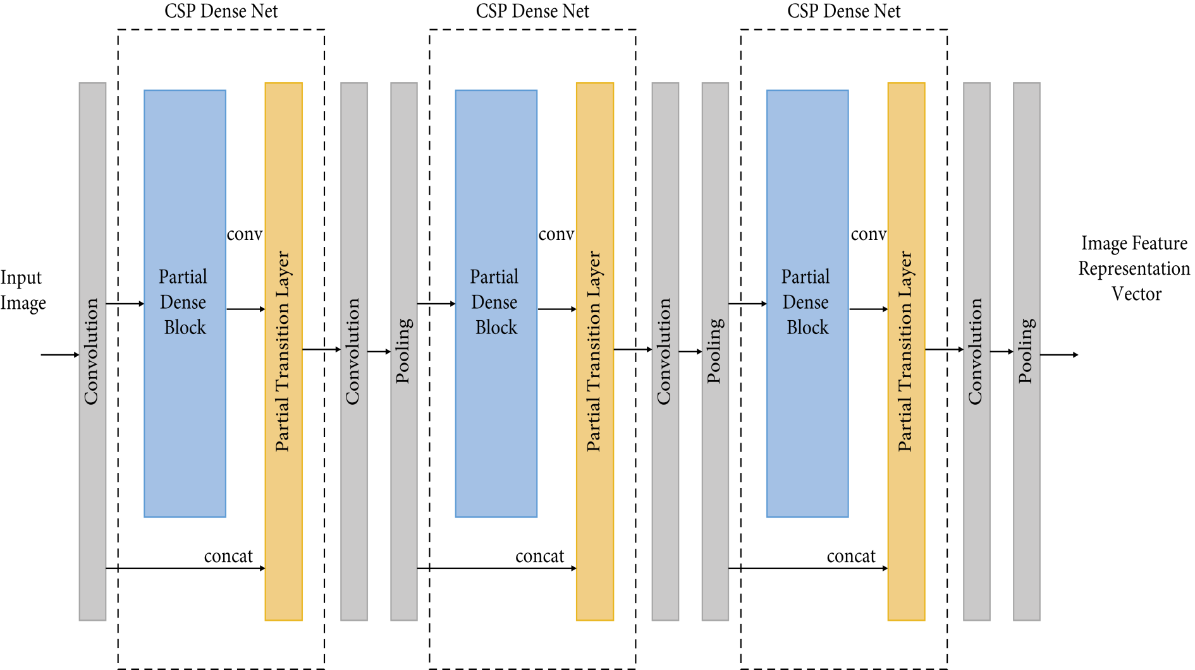
PARTIAL DENSE BLOCKS AND PARTIAL TRANSITION LAYERS
FIGURE 2

Slide 4
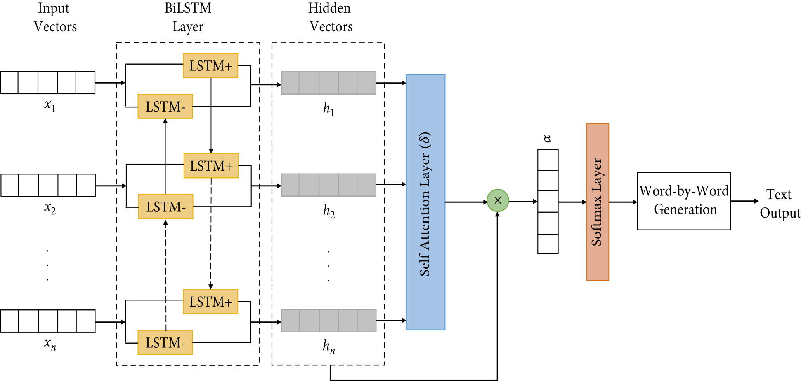
SELF ATTENTION MECHANISM
FIGURE 3

Slide 5
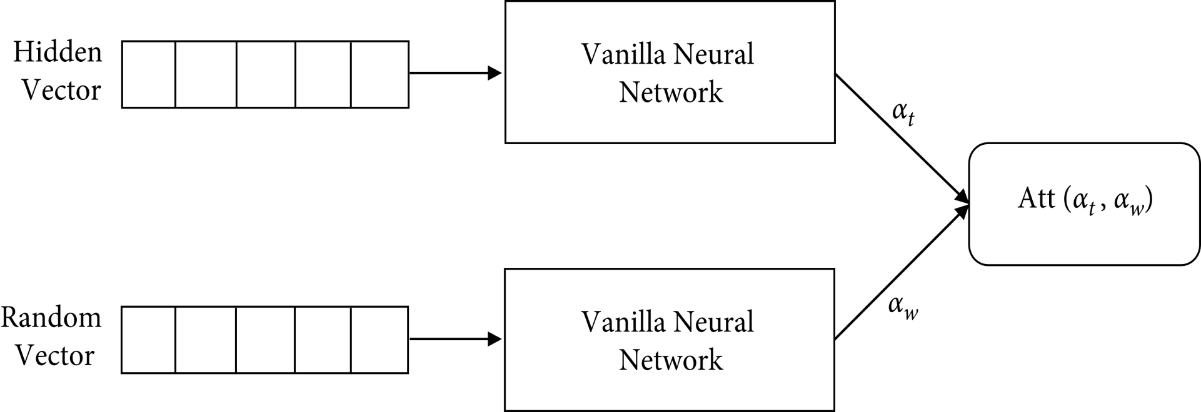
BASIC FLOW DIAGRAM OF SELF ATTENTION MACHANISM
FIGURE 4

Slide 6
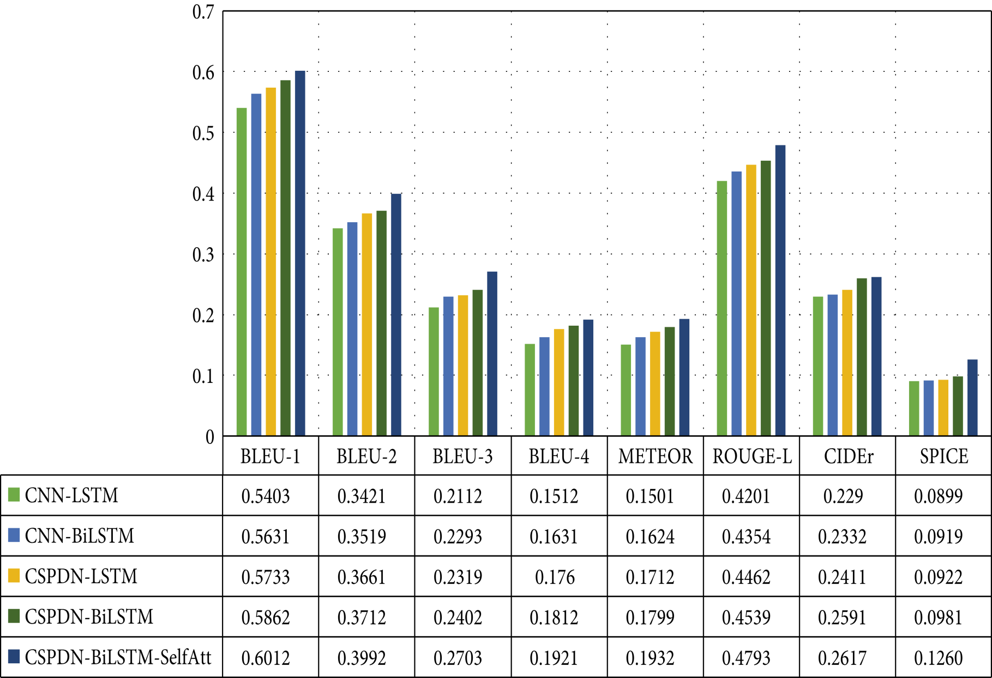
FIGURE 5

Slide 7
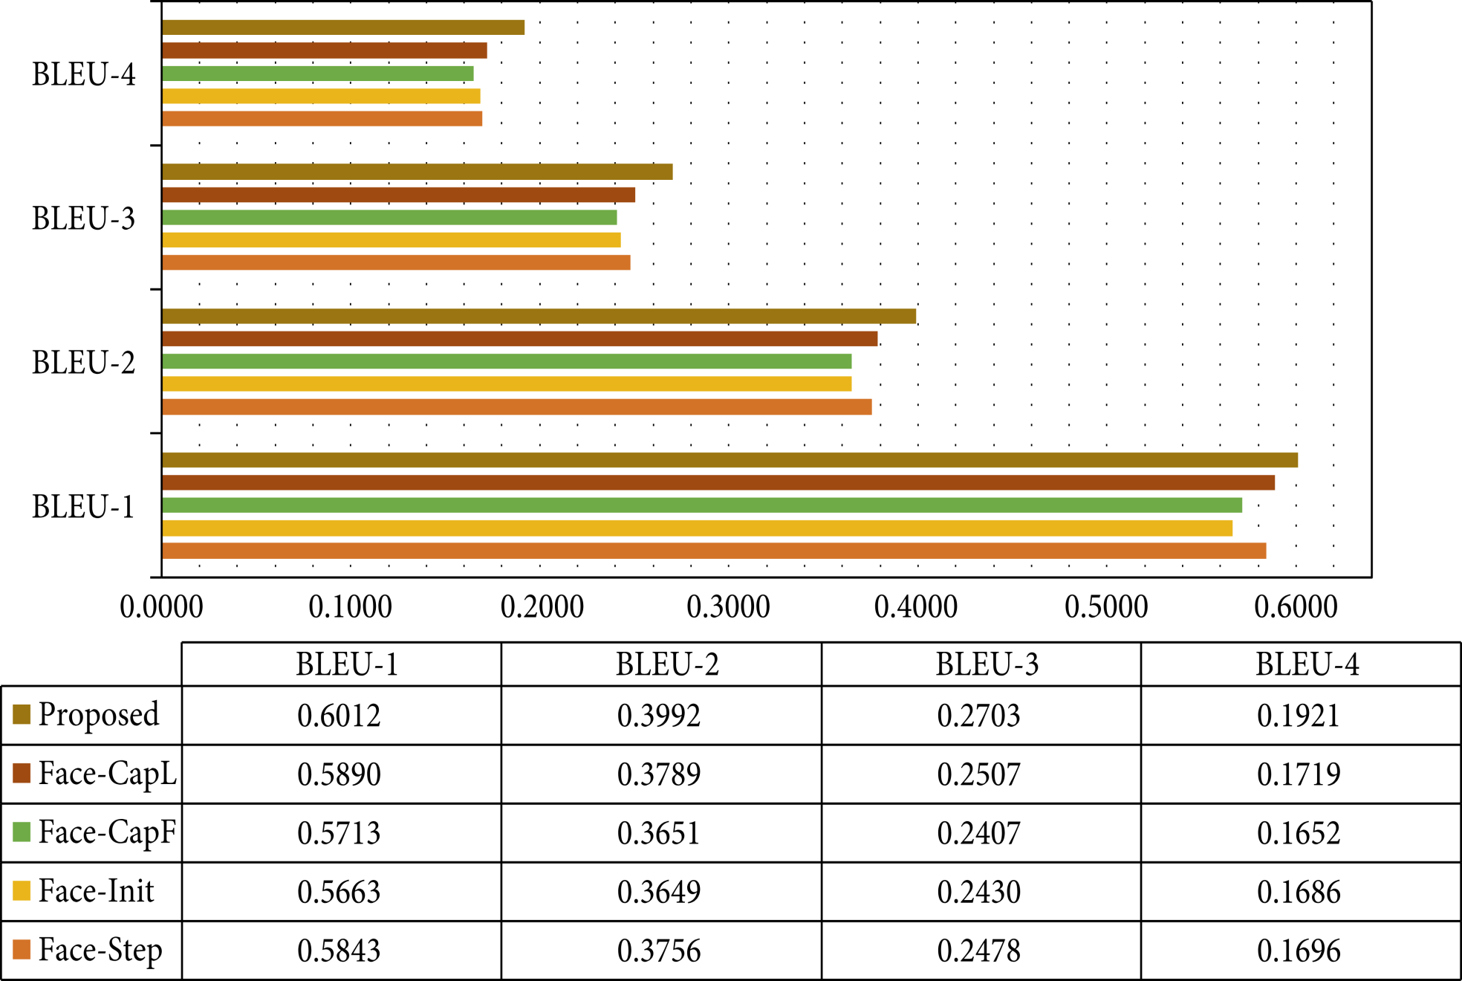
FIGURE 6

Slide 8
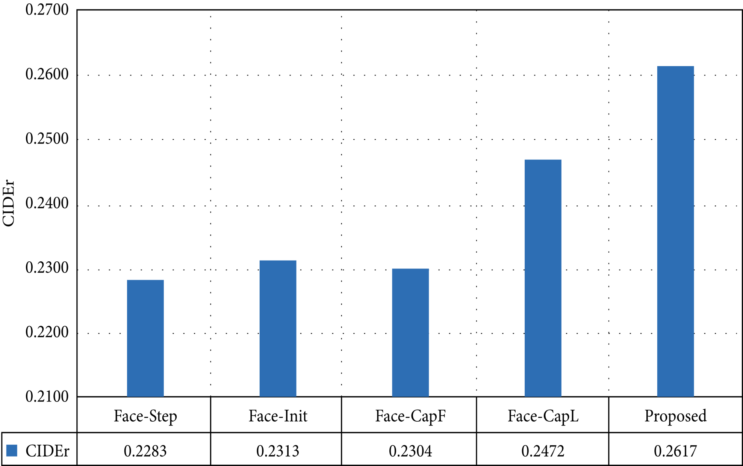
FIGURE 7

Slide 9
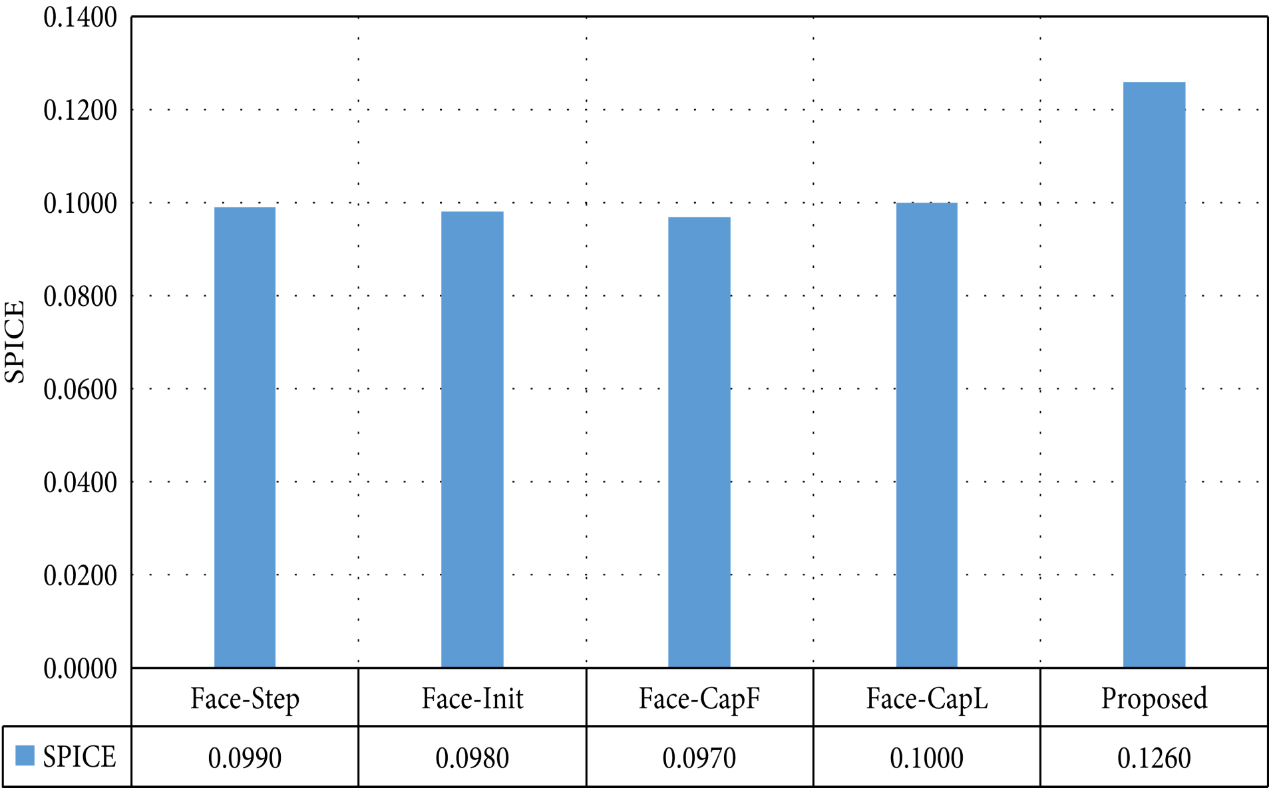
FIGURE 8

Slide 10
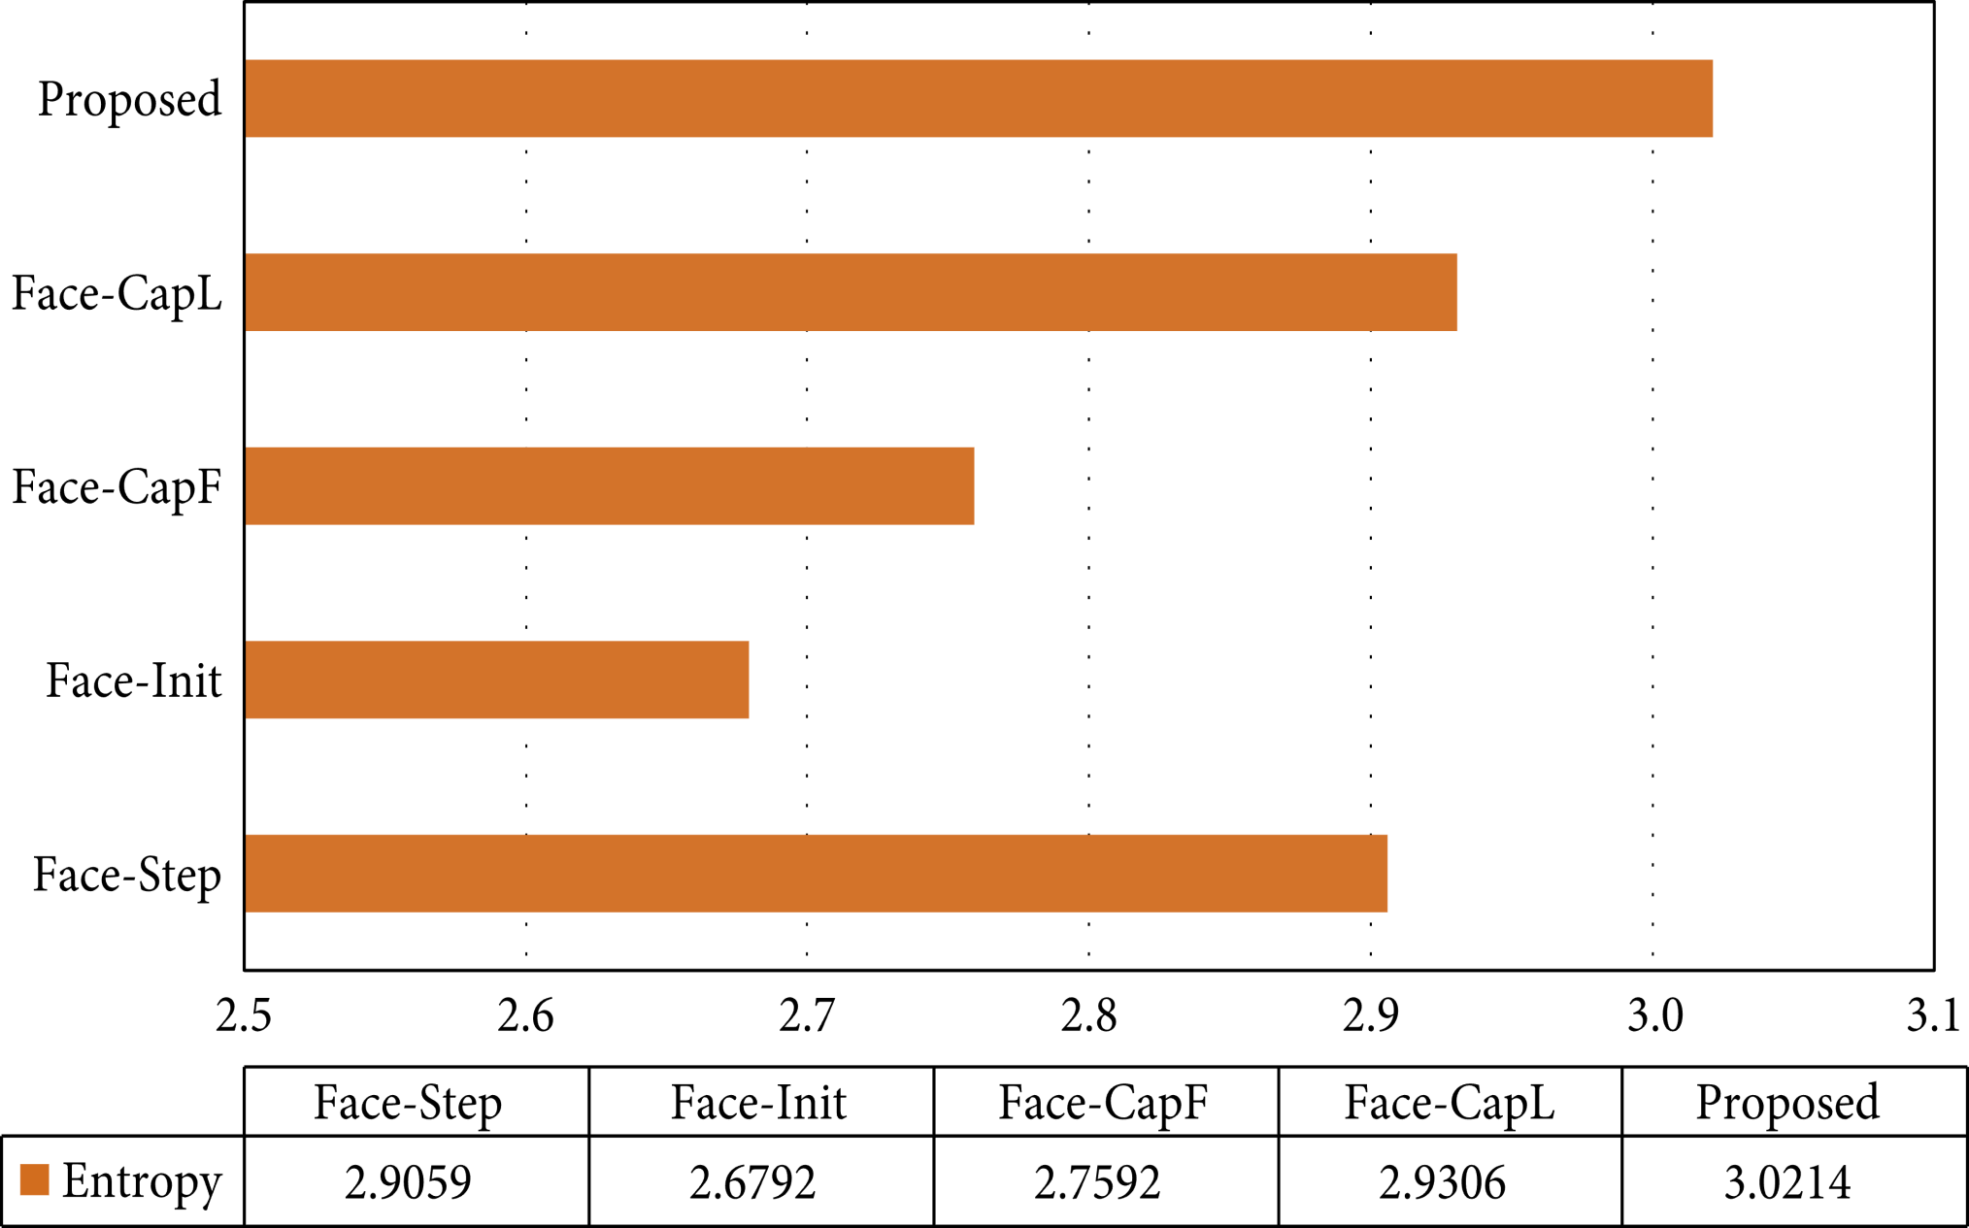
FIGURE 6

Slide 11
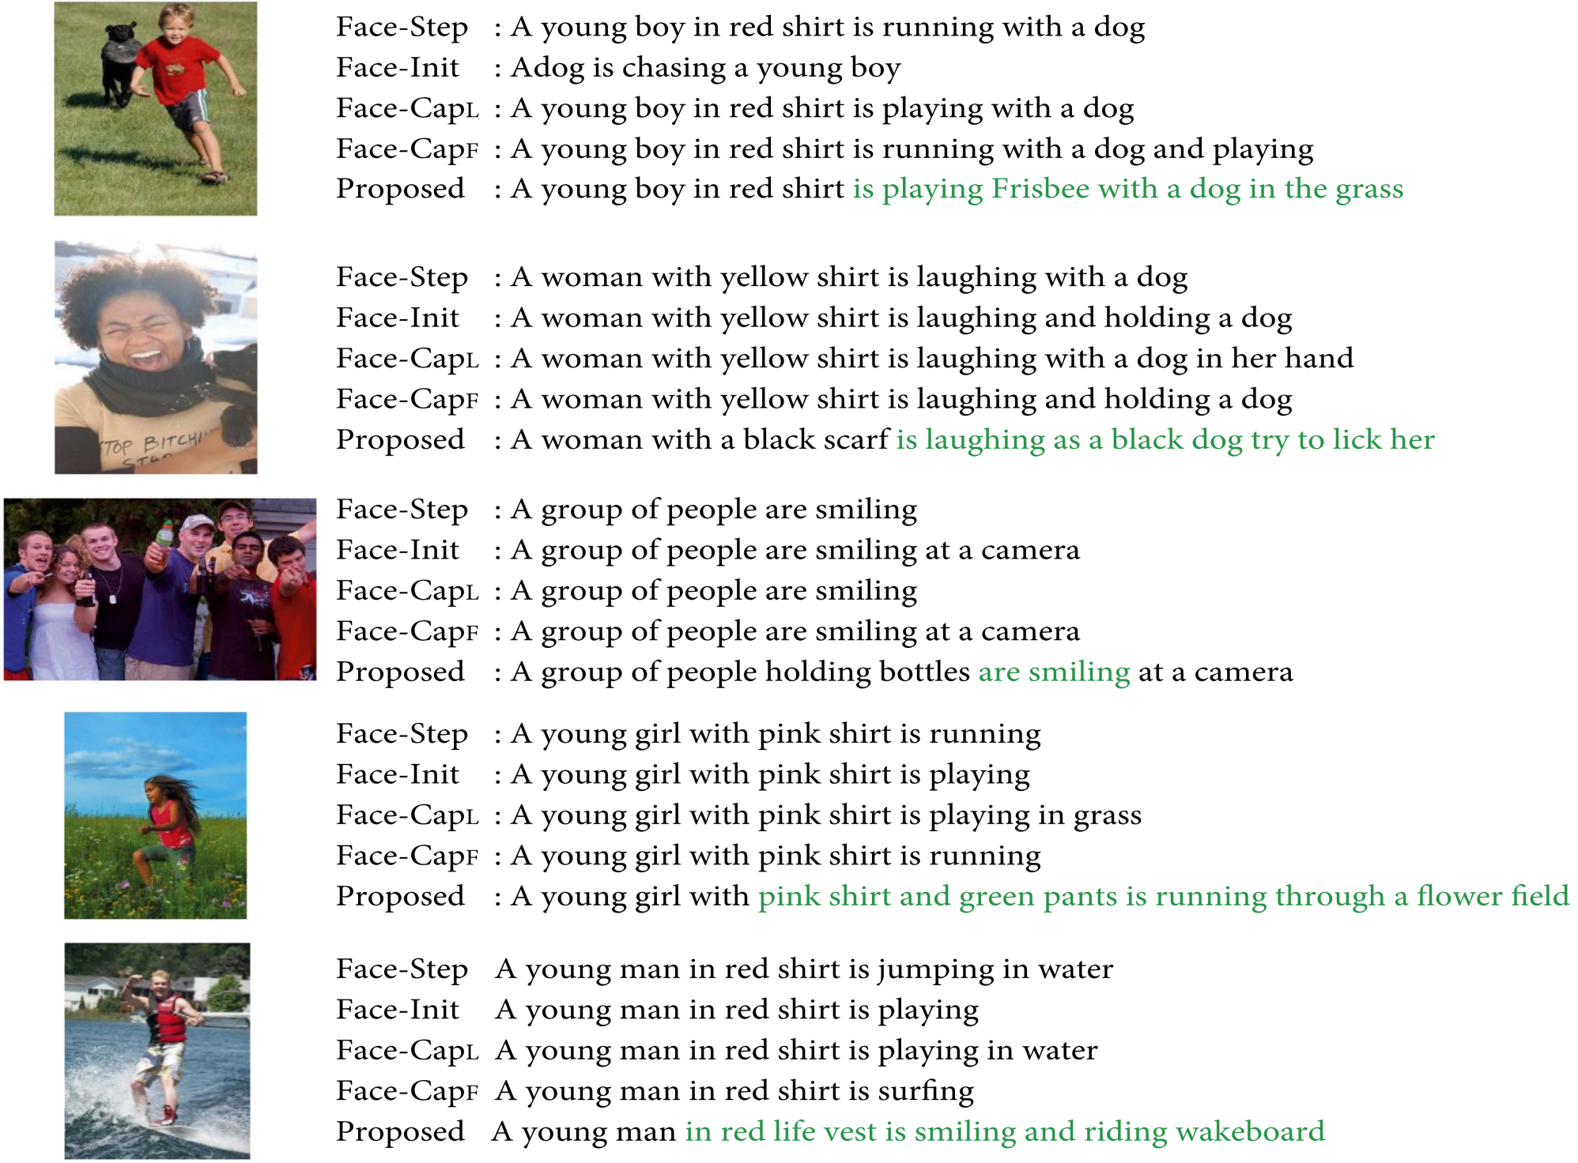

Slide 12
